Slide 1
Discussion of DataSETS
SAMSI: Computational Advertising Workshop 2012

Slide 2
Yahoo! Datasets
Rating Data
  Front Page Today Module User Click Log Data
  Music User Ratings of Musical Artists
Advertising and Marketing Data
  Search Marketing Advertiser Bid-Impression-Click data on competing Keywords
  Search Marketing Advertiser Bidding Data

Slide 3
Yahoo! Datasets
Rating Data
  Front Page Today Module User Click Log Data
  Music User Ratings of Musical Artists
Advertising and Marketing Data
  Search Marketing Advertiser Bid-Impression-Click data on competing Keywords
  Search Marketing Advertiser Bidding Data

Slide 4
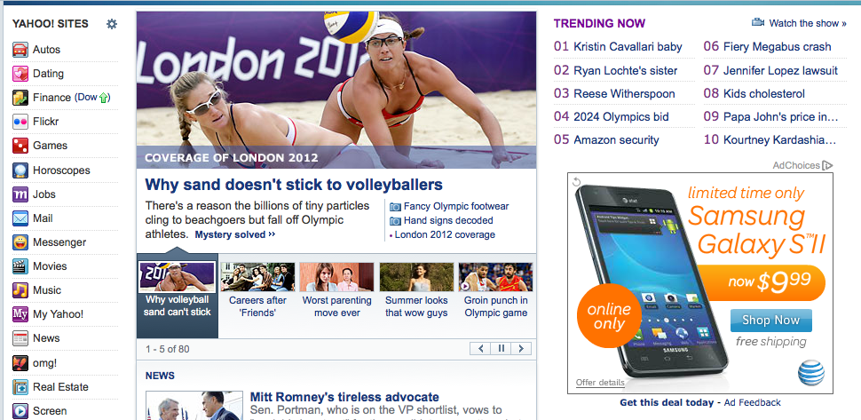
Yahoo! Today Module
F1
Foot Position

Slide 5
Yahoo! Today Module
Story Position
F1
Foot Position

Slide 6
Front Page Today Module User Click Log Data
In this bucket, articles were randomly selected from the article pool to serve users.
To avoid exposure bias at footer positions, we only focused on users’ interaction with F1 articles at the story position.
This dataset contains 10 files, corresponding to the first 10 days in May 2009 (8.4G after unzip):
ydata-fp-td-clicks-v1_0.20090501.gz
ydata-fp-td-clicks-v1_0.20090502.gz
...
ydata-fp-td-clicks-v1_0.20090510.gz

Slide 7
Front Page Today Module User Click Log Data
The dataset contains 45,811,883 visit events.
All user IDs (bcookies) are replaced by a common string 'user' so that no user information can be identified from this data.
Each line corresponds to a separate user visit:
    1241160900 109513 0 |user 2:0.000012 3:0.000000 4:0.000006 5:0.000023 6:0.999958 1:1.000000 |109498 2:0.306008 3:0.000450 4:0.077048 5:0.230439 6:0.386055 1:1.000000 |109509 2:0.306008 3:0.000450 4:0.077048 5:0.230439 6:0.386055 1:1.000000 [[...more article features omitted...]] |109453 2:0.421669 3:0.000011 4:0.010902 5:0.309585 6:0.257833 1:1.000000

Slide 8
Front Page Today Module User Click Log Data
Each user or article is associated with six features.
  Feature #1 is the constant (always 1) feature, and features #2-6 correspond to the 5 membership features constructed via conjoint analysis with a bilinear model [1].
  User Features Derived from over 1000 categorical components
    Demographic: gender, age, geographic features
    Behavioral: user’s consumption history within Yahoo! Properties.
  Article Features Derived from about 100 categorical features
    Inferred article categories by source, or by editor
See [2] for more details about feature construction.
Won’t be able to use the raw features for this dataset.

Slide 9
Features: Different Users, Same Article Pool
1241420100 109574 0
|user 2:0.098523 3:0.006926 4:0.011453 5:0.066320 6:0.816778 1:1.000000
|109476 2:0.421669 3:0.000011 4:0.010902 5:0.309585 6:0.257833 1:1.000000
|109588 2:0.306652 3:0.000038 4:0.231417 5:0.178307 6:0.283587 1:1.000000
|109536 2:0.348058 3:0.000031 4:0.016792 5:0.411669 6:0.223450 1:1.000000
...
|109572 2:0.330608 3:0.000722 4:0.293220 5:0.139609 6:0.235841 1:1.000000
|109589 2:0.214605 3:0.000037 4:0.410493 5:0.097704 6:0.277162 1:1.000000
=======================================================================
1241420100 109572 0
|user 2:0.000442 3:0.000008 4:0.000168 5:0.000466 6:0.998916 1:1.000000
|109476 2:0.421669 3:0.000011 4:0.010902 5:0.309585 6:0.257833 1:1.000000
|109588 2:0.306652 3:0.000038 4:0.231417 5:0.178307 6:0.283587 1:1.000000
|109536 2:0.348058 3:0.000031 4:0.016792 5:0.411669 6:0.223450 1:1.000000
...
|109572 2:0.330608 3:0.000722 4:0.293220 5:0.139609 6:0.235841 1:1.000000
|109589 2:0.214605 3:0.000037 4:0.410493 5:0.097704 6:0.277162 1:1.000000

Slide 10
Features: Different Users, Different Article Pool
1241420100 109574 0
|user 2:0.098523 3:0.006926 4:0.011453 5:0.066320 6:0.816778 1:1.000000
|109476 2:0.421669 3:0.000011 4:0.010902 5:0.309585 6:0.257833 1:1.000000
|109588 2:0.306652 3:0.000038 4:0.231417 5:0.178307 6:0.283587 1:1.000000
|109536 2:0.348058 3:0.000031 4:0.016792 5:0.411669 6:0.223450 1:1.000000
...
|109572 2:0.330608 3:0.000722 4:0.293220 5:0.139609 6:0.235841 1:1.000000
|109589 2:0.214605 3:0.000037 4:0.410493 5:0.097704 6:0.277162 1:1.000000
=======================================================================
1241498100 109609 0
|user 2:0.372187 3:0.021751 4:0.156025 5:0.445635 6:0.004402 1:1.000000
|109476 2:0.421669 3:0.000011 4:0.010902 5:0.309585 6:0.257833 1:1.000000
|109517 2:0.283292 3:0.000001 4:0.022054 5:0.502895 6:0.191758 1:1.000000
|109594 2:0.252976 3:0.000033 4:0.215572 5:0.202255 6:0.329164 1:1.000000
...
|109596 2:0.306008 3:0.000450 4:0.077048 5:0.230439 6:0.386055 1:1.000000
|109597 2:0.149443 3:0.030898 4:0.070599 5:0.131723 6:0.617337 1:1.000000

Slide 11
Details
On May 4, 2009:
  5,432,561 visit event recorded.
  Every 300s, snapshots of user click behavior were taken.
  Every time, 20 articles were available in the content pool.
  Totally 47 articles were shown on the day.
Article views and clicks are changing over time.

Slide 12
Article 109476: Views and Click Through Rate

Slide 13
Article 109578: Views and Click Through Rate

Slide 14
Front Page Today Module User Click Log Data
A unique property of this data set is that the displayed article is chosen uniformly at random from the candidate article pool.
Therefore, one can use an unbiased *offline* evaluation method [2,3] to compare bandit algorithms in a reliable way. Performance of some of the popular bandit algorithms can be found [2].

Slide 15
Yahoo! Datasets
Rating Data
  Front Page Today Module User Click Log Data
  Music User Ratings of Musical Artists
Advertising and Marketing Data
  Search Marketing Advertiser Bid-Impression-Click data on competing Keywords
  Search Marketing Advertiser Bidding Data

Slide 16
Music User Ratings of Musical Artists
The dataset contains 115,579,440 ratings of 98,211 artists by 1,948,882 anonymous Yahoo! Music users over the course of a one month period sometime prior to March 2004.
User ratings of music artists: ydata-ymusic-user-artist-ratings-v1_0.txt.gz
  Snippet:
    1 1000125 90
    1 1006373 100
    1 1006978 90
    1 1007035 100
    1 1007098 100
  The ratings are integers ranging from 0 to 100, except 255 (a special case that means "never play again").
Artist Id and name of each musical artist: ydata-ymusic-artist-names-v1_0.txt.gz

Slide 17
Music User Ratings of Musical Artists
115,579,440 ratings on 98,211 artists by 1,948,882 users
Long Tails:
  User: 1,310,771 did > 10 ratings, 586,280 did > 50 ratings
  Artist: 65,996 had > 10 ratings, 29,745 had > 50 ratings

Slide 18
Music User Ratings of Musical Artists
Only 49,995 artist have average rating > 0

Slide 19
Music User Ratings of Musical Artists
Sparse ratings.
Can be used to validate recommender systems or collaborative filtering algorithms may use this dataset.
The dataset may serve as a test bed for matrix and graph algorithms including PCA and clustering algorithms [4,5].
Similar topics have been explored at KDD Cup

Slide 20
Yahoo! Datasets
Rating Data
  Front Page Today Module User Click Log Data
  Music User Ratings of Musical Artists
Advertising and Marketing Data
  Search Marketing Advertiser Bid-Impression-Click data on competing Keywords
  Search Marketing Advertiser Bidding Data

Slide 21
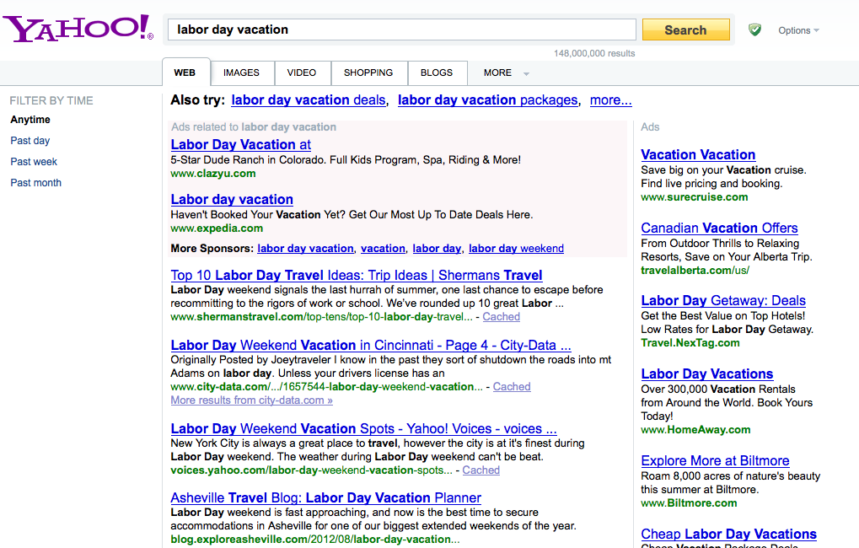
Bid the right to appear
Rank 1
Rank 2
…

Slide 22
Search Marketing Advertiser Bid-Impression-Click data on competing Keywords
This dataset contains a small sample of advertiser's bid and revenue information over a period of 4 months. All bidder and keywords are anonymized.
ydata-ysm-keyphrase-bid-imp-click-v1_0.gz contains the following fields: day, account id, rank, keyphrase (list of keywords), average bid, impressions, clicks
    Bid and revenue information is aggregated with a granularity of a day over advertiser account id, key phrase and rank. Apart from bid and revenue, impressions and clicks information is also included.
ydata-ysm-keyphrase-category-v1_0.txt contains 6 keywords.

Slide 23
Search Marketing Advertiser Bid-Impression-Click data on competing Keywords
Snippet:
1 08bade48-1081-488f-b459-6c75d75312ae 2 2affa525151b6c51 79021a2e2c836c1a 327e089362aac70c fca90e7f73f3c8ef af26d27737af376a 100.0 2.0 0.0
29 08bade48-1081-488f-b459-6c75d75312ae 3 769ed4a87b5010f4 3d4b990abb0867c8 cd74a8342d25d090 ab9f74ae002e80ff af26d27737af376a 100.0 1.0 0.0
29 08bade48-1081-488f-b459-6c75d75312ae 2 769ed4a87b5010f4 3d4b990abb0867c8 cd74a8342d25d090 ab9f74ae002e80ff af26d27737af376a 100.0 1.0 0.0
11 08bade48-1081-488f-b459-6c75d75312ae 1 769ed4a87b5010f4 3d4b990abb0867c8 cd74a8342d25d090 ab9f74ae002e80ff af26d27737af376a 100.0 2.0 0.0
76 08bade48-1081-488f-b459-6c75d75312ae 2 769ed4a87b5010f4 3d4b990abb0867c8 cd74a8342d25d090 ab9f74ae002e80ff af26d27737af376a 100.0 1.0 0.0
48 08bade48-1081-488f-b459-6c75d75312ae 3 2affa525151b6c51 79021a2e2c836c1a 327e089362aac70c fca90e7f73f3c8ef af26d27737af376a 100.0 2.0 0.0
97 08bade48-1081-488f-b459-6c75d75312ae 2 2affa525151b6c51 79021a2e2c836c1a 327e089362aac70c fca90e7f73f3c8ef af26d27737af376a 100.0 1.0 0.0
123 08bade48-1081-488f-b459-6c75d75312ae 5 769ed4a87b5010f4 3d4b990abb0867c8 cd74a8342d25d090 ab9f74ae002e80ff af26d27737af376a 100.0 1.0 0.0
119 08bade48-1081-488f-b459-6c75d75312ae 3 2affa525151b6c51 79021a2e2c836c1a 327e089362aac70c fca90e7f73f3c8ef af26d27737af376a 100.0 1.0 0.0
73 08bade48-1081-488f-b459-6c75d75312ae 1 2affa525151b6c51 79021a2e2c836c1a 327e089362aac70c fca90e7f73f3c8ef af26d27737af376a 100.0 1.0 0.0

Slide 24
Search Marketing Advertiser Bid-Impression-Click data on competing Keywords
Average bid over account Id, keyphrase and rank are given along with impressions and clicks.
Can be used to derive bidding strategy and doing optimization: across bidders, over time, over rank, over keyphrase.

Slide 25
Yahoo! Datasets
Rating Data
  Front Page Today Module User Click Log Data
  Music User Ratings of Musical Artists
Advertising and Marketing Data
  Search Marketing Advertiser Bid-Impression-Click data on competing Keywords
  Search Marketing Advertiser Bidding Data

Slide 26
Search Marketing Advertiser Bidding Data
This dataset contains the bids over time of all advertisers participating in Yahoo! Search Marketing auctions for the top 1000 search queries during the period from June 15, 2002, to June 14, 2003.
  18,634,347 bids for the top 1,000 phrases
  10,475 bidders
  Bid recorded every 15 minutes
  Price is denominated in US dollars.

Slide 27
Search Marketing Advertiser Bidding Data
Timestamp, Phrase Id, Account Id, Price, Auto(binary, whether placed by an automatic bidding program)
  Data snippet:
06/15/2002 00:00:00 39 691 1.34 0
06/15/2002 00:00:00 40 691 1.16 0
06/15/2002 00:00:00 83 691 0.85 0
06/15/2002 00:00:00 1 741 13.71 0
06/15/2002 00:00:00 1 741 13.73 0
Detailed real time bidding but no impression or click data available.
Can be used to study bidder behavior and bidding strategy [6,7,8,9].

Slide 28
References
[1] Wei Chu, Seung-Taek Park, Todd Beaupre, Nitin Motgi, Amit Phadke, Seinjuti Chakraborty, Joe Zachariah: A case study of behavior-driven conjoint analysis on Yahoo!: Front page today module. Proceedings of the 15th ACM SIGKDD International Conference on Knowledge Discovery and Data Mining, 1097-1104, 2009.
[2] Lihong Li, Wei Chu, John Langford, Robert E. Schapire: A contextual-bandit approach to personalized news article recommendation. Proceedings of the 19th International Conference on World Wide Web, 661-670, 2010.
[3] Lihong Li, Wei Chu, John Langford, Xuanhui Wang: Unbiased offline evaluation of contextual-bandit-based news article recommendation algorithms. Proceedings of the Forth International Conference on Web Search and Web Data Mining, 297-306, 2011.
[4] Justin Dyer and Art Owen. Visualizing bivariate long tailed data. Technical report, Stanford University, Statistics, 2010.
[5] Abhay Goel, Prerak Trivedi. Finding Similar Music Artists for Recommendation.

Slide 29
References
[6] Benjamin Edelman and Michael Ostrovsky. Strategic bidder behavior in sponsored search auctions. In Workshop on Sponsored Search Auctions, ACM Electronic Commerce, 2005.
[7] Jia Yuan. Examining the Yahoo! Sponsored Search Auctions: A Regression Discontinuity Design Approach. International Journal of Economics and Finance. Vol 4, No 3, 2012.
[8] Jason Auerbach, Joel Galenson, and Mukund Sundararajan. “An Empirical Analysis of Return on Investment Maximization in Sponsored Search Auctions.” In Proceedings of the Second International Workshop on Data Mining and Audience Intelligence for Advertising (ADKDD), 2008.
[9] Tilman Borgers, Ingemar Cox, Martin Pesendorfer, Vaclav Petricek. 2007. Equilibrium bids in sponsored search auctions: Theory and evidence. Mimeo.

