Slide 1
Avoiding Communication in Numerical Linear Algebra
Jim Demmel
EECS & Math Departments
UC Berkeley

Slide 2
Outline
Why we need to “avoid communication,” i.e. avoid moving data
“Direct” Linear Algebra
Lower bounds on communication for linear algebra problems like Ax=b, least squares, Ax = λx, SVD, etc
New algorithms that attain these lower bounds
Not in libraries like Sca/LAPACK (yet!)
Large speed-ups possible
“Iterative” Linear Algebra
Ditto for Krylov Subspace Methods

Slide 3
Why avoid communication? (1/2)
Algorithms have two costs:
Arithmetic (FLOPS)
Communication: moving data between
levels of a memory hierarchy (sequential case)
processors over a network (parallel case).
CPU
Cache
CPU
DRAM
CPU
DRAM
DRAM
CPU
DRAM
CPU
DRAM

Slide 4
Why avoid communication? (2/2)
Running time of an algorithm is sum of 3 terms:
# flops * time_per_flop
# words moved / bandwidth
# messages * latency
communication
Time_per_flop << 1/ bandwidth << latency
Gaps growing exponentially with time (FOSC, 2004)
Annual improvements
Time_per_flop |  | Bandwidth | Latency
 | Network | 26% | 15%
 | DRAM | 23% | 5%
59%
Goal : reorganize linear algebra to avoid communication
Between all memory hierarchy levels
L1 L2 DRAM network, etc
Arbitrary speedups possible
Notes:
2008 DARPA Exascale report has similar prediction:
Gap between DRAM access time and flops will increase
100x over coming decade to balance power usage between
processors, DRAM

Slide 5
President Obama cites Communication-Avoiding algorithms in the FY 2012 Department of Energy Budget Request to Congress:
“New Algorithm Improves Performance and Accuracy on Extreme-Scale Computing Systems. On modern computer architectures, communication between processors takes longer than the performance of a floating point arithmetic operation by a given processor. ASCR researchers have developed a new method, derived from commonly used linear algebra methods, to minimize communications between processors and the memory hierarchy, by reformulating the communication patterns specified within the algorithm. This method has been implemented in the TRILINOS framework, a highly-regarded suite of software, which provides functionality for researchers around the world to solve large scale, complex multi-physics problems.”
FY 2010 Congressional Budget, Volume 4, FY2010 Accomplishments, Advanced Scientific Computing Research (ASCR), pages 65-67.
CA-GMRES
(Hoemmen, Mohiyuddin, Yelick, D.)

Slide 6
Direct linear algebra: Prior Work on Matmul
Assume n³ algorithm for C=A*B (i.e. not Strassen-like)
Sequential case, with fast memory of size M
Lower bound on #words moved to/from slow memory = Ω (n³ / M^{1/2} ) [Hong, Kung, 81]
Attained using “blocked” or cache-oblivious algorithms
Parallel case on P processors:
Assume load balanced, one copy each of A, B, C
Lower bound on #words communicated = Ω (n² / P^{1/2} ) [Irony, Tiskin, Toledo, 04]
Attained by Cannon’s Algorithm
NNZ | Lower bound on #words | Attained by
3n² (“2D alg”) | Ω (n² / P^{1/2} ) | [Cannon, 69]
3n² P^{1/3} (“3D alg”) | Ω (n² / P^{2/3} ) | [Johnson,93]
Notes:
All true for dense or sparse, LU, Cholesky (complete or incomplete),
And we also believe QR

Slide 7
Lower bound for all “direct” linear algebra
Let M = “fast” memory size (per processor)
#words_moved (per processor) = Ω(#flops (per processor) / M^{1/2} )
#messages_sent (per processor) = Ω(#flops (per processor) / M^{3/2} )
Holds for anything that “smells like” 3 nested loops:
Matmul, LU, QR, eig, SVD, tensor contractions, …
Some whole programs (sequences of these operations, no matter how individual ops are interleaved, eg A^{k})
Dense and sparse matrices (where #flops << n³ )
Sequential and parallel algorithms
Some graph-theoretic algorithms (eg Floyd-Warshall)

Slide 8
Can we attain these lower bounds?
Do conventional dense algorithms as implemented in LAPACK and ScaLAPACK attain these bounds?
Mostly not
If not, are there other algorithms that do?
Yes, for dense linear algebra
Only a few sparse algorithms so far

Slide 9
TSQR: QR of a Tall, Skinny matrix
W₀
W₁
W₂
W₃
Q₀₀ R₀₀
Q₁₀ R₁₀
Q₂₀ R₂₀
Q₃₀ R₃₀
Q₀₀
Q₁₀
Q₂₀
Q₃₀
R₀₀
R₁₀
R₂₀
R₃₀
W =
=
=
.
R₀₀
R₁₀
R₂₀
R₃₀
Q₀₁ R₀₁
Q₁₁ R₁₁
Q₀₁
Q₁₁
R₀₁
R₁₁
=
=
.
R₀₁
R₁₁
=
Q₀₂ R₀₂

Slide 10
TSQR: QR of a Tall, Skinny matrix
W₀
W₁
W₂
W₃
Q₀₀ R₀₀
Q₁₀ R₁₀
Q₂₀ R₂₀
Q₃₀ R₃₀
Q₀₀
Q₁₀
Q₂₀
Q₃₀
R₀₀
R₁₀
R₂₀
R₃₀
W =
=
=
.
R₀₀
R₁₀
R₂₀
R₃₀
Q₀₁ R₀₁
Q₁₁ R₁₁
Q₀₁
Q₁₁
R₀₁
R₁₁
=
=
.
R₀₁
R₁₁
=
Q₀₂ R₀₂

Slide 11
Minimizing Communication in TSQR
W₀
W₁
W₂
W₃
R₀₀
R₁₀
R₂₀
R₃₀
R₀₁
Parallel:
W =
R₀₂
R₁₁
W₀
W₁
W₂
W₃
R₀₀
Sequential:
R₀₁
W =
R₀₂
R₀₃
W₀
W₁
W₂
W₃
R₀₀
R₀₁
Dual Core:
R₀₁
W =
R₀₂
R₁₁
R₀₃
R₁₁
Multicore / Multisocket / Multirack / Multisite / Out-of-core: ?
Can choose reduction tree dynamically
Notes:
Oldest reference for idea of tree: Golub/Plemmons/Sameh 1988,
But didn’t avoid communication

Slide 12
TSQR Performance Results
Parallel
Intel Clovertown
Up to 8x speedup (8 core, dual socket, 10M x 10)
Pentium III cluster, Dolphin Interconnect, MPICH
Up to 6.7x speedup (16 procs, 100K x 200)
BlueGene/L
Up to 4x speedup (32 procs, 1M x 50)
Tesla C 2050 / Fermi
Up to 13x (110,592 x 100)
Grid – 4x on 4 cities (Dongarra et al)
Cloud – early result – up and running
Sequential
“Infinite speedup” for out-of-Core on PowerPC laptop
As little as 2x slowdown vs (predicted) infinite DRAM
LAPACK with virtual memory never finished
Data from Grey Ballard, Mark Hoemmen, Laura Grigori, Julien Langou, Jack Dongarra, Michael Anderson
Notes:
Transition: TSQR -> CAQR

Slide 13
Summary of dense parallel algorithms attaining communication lower bounds
Assume nxn matrices on P processors, memory per processor = O(n² / P)
ScaLAPACK assumes best block size b chosen
Many references (see reports), Green are ours
Recall lower bounds:
#words_moved = Ω( n² / P^{1/2} ) and #messages = Ω( P^{1/2} )
Algorithm | Reference | Factor exceeding lower bound for #words_moved | Factor exceeding lower bound for #messages
Matrix multiply | [Cannon, 69] | 1 | 1
Cholesky | ScaLAPACK | log P | log P
LU | [GDX08] ScaLAPACK | log P log P | log P ( N / P^{1/2} ) · log P
QR | [DGHL08] ScaLAPACK | log P log P | log³ P ( N / P^{1/2} ) · log P
Sym Eig, SVD | [BDD10] ScaLAPACK | log P log P | log³ P N / P^{1/2}
Nonsym Eig | [BDD10] ScaLAPACK | log P P^{1/2} · log P | log³ P N · log P

Slide 14
Exascale Machine Parameters
2^30 ≈ 1,000,000 nodes
1024 cores/node (a billion cores!)
100 GB/sec interconnect bandwidth
400 GB/sec DRAM bandwidth
1 microsec interconnect latency
50 nanosec memory latency
32 Petabytes of memory
1/2 GB total L1 on a node
20 Megawatts !?

Slide 15
Exascale predicted speedups for CA-LU vs ScaLAPACK-LU
log₂ (n²/p) =
log₂ (memory_per_proc)
log₂ (p)
Notes:
Vertical axis log2(n^2/p) is memory per processor
Horizontal axis log2(p) is processor count

Slide 16
Summary of dense parallel algorithms attaining communication lower bounds
Assume nxn matrices on P processors, memory per processor = O(n² / P)
ScaLAPACK assumes best block size b chosen
Many references (see reports), Green are ours
Recall lower bounds:
#words_moved = Ω( n² / P^{1/2} ) and #messages = Ω( P^{1/2} )
Algorithm | Reference | Factor exceeding lower bound for #words_moved | Factor exceeding lower bound for #messages
Matrix multiply | [Cannon, 69] | 1 | 1
Cholesky | ScaLAPACK | log P | log P
LU | [GDX08] ScaLAPACK | log P log P | log P ( N / P^{1/2} ) · log P
QR | [DGHL08] ScaLAPACK | log P log P | log³ P ( N / P^{1/2} ) · log P
Sym Eig, SVD | [BDD10] ScaLAPACK | log P log P | log³ P N / P^{1/2}
Nonsym Eig | [BDD10] ScaLAPACK | log P P^{1/2} · log P | log³ P N · log P
Can we do better?

Slide 17
Summary of dense parallel algorithms attaining communication lower bounds
Assume nxn matrices on P processors, memory per processor = O(n² / P)? Why?
ScaLAPACK assumes best block size b chosen
Many references (see reports), Green are ours
Recall lower bounds:
#words_moved = Ω( n² / P^{1/2} ) and #messages = Ω( P^{1/2} )
Algorithm | Reference | Factor exceeding lower bound for #words_moved | Factor exceeding lower bound for #messages
Matrix multiply | [Cannon, 69] | 1 | 1
Cholesky | ScaLAPACK | log P | log P
LU | [GDX08] ScaLAPACK | log P log P | log P ( N / P^{1/2} ) · log P
QR | [DGHL08] ScaLAPACK | log P log P | log³ P ( N / P^{1/2} ) · log P
Sym Eig, SVD | [BDD10] ScaLAPACK | log P log P | log³ P N / P^{1/2}
Nonsym Eig | [BDD10] ScaLAPACK | log P P^{1/2} · log P | log³ P N · log P
Can we do better?

Slide 18
Beating #words_moved = Ω(n²/P^{1/2})
#words_moved = Ω((n³/P)/local_mem^{1/2})
If one copy of data, local_mem = n²/P
Can we use more memory to communicate less?
“2.5D” Algorithms
Usual “2D” approach: 1 copy of data on P^{1/2} x P^{1/2} grid
Instead use “2.5D”: c copies of data on (P/c)^{1/2} x (P/c)^{1/2} x c grid
Each of c layers does 1/c-th of the work
Reduces communication volume of Matmul, LU, by c^{1/2} - optimal
c limited to 1 ≤ c ≤ P^{1/3}
Reduces communication up to 92% on 64K proc BG-P,
LU & Matmul speedup up to 2.6x
k
“C face”
Cube representing
C(1,1) += A(1,3)*B(3,1)
C(2,3)
C(1,1)
A(1,3)
B(3,1)
j
B(1,3)
A(2,1)
“B face”
i
“A face”
Notes:
Extension to c by McColl and Tiskin in CRCW PRAM model in 1999
Ashcraft, Toledo tried LU, failed but we can!
Aggarwal, Chandra, Snir 1988
Bernsten, 1988
Gupta, Kumar 1993
Johnson, 1993
Distinguished paper award, EuroPar’11

Slide 19
Lower bound for Strassen’s fast matrix multiplication
For Strassen’s:
Strassen-like:
Recall O(n³) case:
log₂ 7
ω₀
log₂ 8
Sequential:
Parallel:
The parallel lower bounds applies to
2D: M = Θ(n²/P)
2.5D: M = Θ(c∙n²/P)
Attainable
Sequential: usual recursive algorithms, also for LU, QR, eig, SVD,…
Parallel: just matmul so far …
[Ballard, Demmel, Holtz, S. 2011b]:
The Communication bandwidth lower bound is
Notes:
BW recursion: contract sub-trees corresponding to matrices of M/3 elements to leaves, of cost M
Best Paper Prize, SPAA’11

Slide 20
Summary of Direct Linear Algebra
New lower bounds, optimal algorithms, big speedups in theory and practice
Lots of other progress, open problems
New ways to “pivot”
Strassen-like algorithms
Heterogeneous architectures
Some sparse algorithms
Autotuning. . .

Slide 21
Avoiding Communication in Iterative Linear Algebra
k-steps of iterative solver for sparse Ax=b or Ax=λx
Does k SpMVs with A and starting vector
Many such “Krylov Subspace Methods”
Conjugate Gradients (CG), GMRES, Lanczos, Arnoldi, …
Goal: minimize communication
Assume matrix “well-partitioned”
Serial implementation
Conventional: O(k) moves of data from slow to fast memory
New: O(1) moves of data – optimal
Parallel implementation on p processors
Conventional: O(k log p) messages (k SpMV calls, dot prods)
New: O(log p) messages - optimal
Lots of speed up possible (modeled and measured)
Price: some redundant computation
21
Notes:
Well – partitioned = modest surface-to-volume ratio
See bebop.cs.berkeley.edu
CG: [van Rosendale, 83], [Chronopoulos and Gear, 89]
GMRES: [Walker, 88], [Joubert and Carey, 92], [Bai et al., 94]

Slide 22
Communication Avoiding Kernels: The Matrix Powers Kernel : [Ax, A²x, …, A^{k}x]
Replace k iterations of y = A⋅x with [Ax, A²x, …, A^{k}x]
Example: A tridiagonal, n=32, k=3
Works for any “well-partitioned” A
A³·x
A²·x
A·x
x
1 2 3 4 …
… 32
Notes:
C. J. Pfeifer, Data flow and storage allocation for the PDQ-5 program on the Philco-2000, Comm. ACM 6, No. 7 (1963), 365366.
Referred to in paper by Leiserson/Rao/Toledo/ in 1993 paper on blocking covers

Slide 23
Communication Avoiding Kernels: The Matrix Powers Kernel : [Ax, A²x, …, A^{k}x]
Replace k iterations of y = A⋅x with [Ax, A²x, …, A^{k}x]
Example: A tridiagonal, n=32, k=3
A³·x
A²·x
A·x
x
1 2 3 4 …
… 32

Slide 24
Communication Avoiding Kernels: The Matrix Powers Kernel : [Ax, A²x, …, A^{k}x]
Replace k iterations of y = A⋅x with [Ax, A²x, …, A^{k}x]
Example: A tridiagonal, n=32, k=3
A³·x
A²·x
A·x
x
1 2 3 4 …
… 32

Slide 25
Communication Avoiding Kernels: The Matrix Powers Kernel : [Ax, A²x, …, A^{k}x]
Replace k iterations of y = A⋅x with [Ax, A²x, …, A^{k}x]
Example: A tridiagonal, n=32, k=3
A³·x
A²·x
A·x
x
1 2 3 4 …
… 32

Slide 26
Communication Avoiding Kernels: The Matrix Powers Kernel : [Ax, A²x, …, A^{k}x]
Replace k iterations of y = A⋅x with [Ax, A²x, …, A^{k}x]
Example: A tridiagonal, n=32, k=3
A³·x
A²·x
A·x
x
1 2 3 4 …
… 32

Slide 27
Communication Avoiding Kernels: The Matrix Powers Kernel : [Ax, A²x, …, A^{k}x]
Replace k iterations of y = A⋅x with [Ax, A²x, …, A^{k}x]
Example: A tridiagonal, n=32, k=3
A³·x
A²·x
A·x
x
1 2 3 4 …
… 32

Slide 28
Communication Avoiding Kernels: The Matrix Powers Kernel : [Ax, A²x, …, A^{k}x]
Replace k iterations of y = A⋅x with [Ax, A²x, …, A^{k}x]
Sequential Algorithm
Example: A tridiagonal, n=32, k=3
Step 1
A³·x
A²·x
A·x
x
1 2 3 4 …
… 32

Slide 29
Communication Avoiding Kernels: The Matrix Powers Kernel : [Ax, A²x, …, A^{k}x]
Replace k iterations of y = A⋅x with [Ax, A²x, …, A^{k}x]
Sequential Algorithm
Example: A tridiagonal, n=32, k=3
Step 1
Step 2
A³·x
A²·x
A·x
x
1 2 3 4 …
… 32

Slide 30
Communication Avoiding Kernels: The Matrix Powers Kernel : [Ax, A²x, …, A^{k}x]
Replace k iterations of y = A⋅x with [Ax, A²x, …, A^{k}x]
Sequential Algorithm
Example: A tridiagonal, n=32, k=3
Step 1
Step 2
Step 3
A³·x
A²·x
A·x
x
1 2 3 4 …
… 32

Slide 31
Communication Avoiding Kernels: The Matrix Powers Kernel : [Ax, A²x, …, A^{k}x]
Replace k iterations of y = A⋅x with [Ax, A²x, …, A^{k}x]
Sequential Algorithm
Example: A tridiagonal, n=32, k=3
Step 1
Step 2
Step 3
Step 4
A³·x
A²·x
A·x
x
1 2 3 4 …
… 32

Slide 32
Communication Avoiding Kernels: The Matrix Powers Kernel : [Ax, A²x, …, A^{k}x]
Replace k iterations of y = A⋅x with [Ax, A²x, …, A^{k}x]
Parallel Algorithm
Example: A tridiagonal, n=32, k=3
Each processor communicates once with neighbors
Proc 1
Proc 2
Proc 3
Proc 4
A³·x
A²·x
A·x
x
1 2 3 4 …
… 32

Slide 33
Communication Avoiding Kernels: The Matrix Powers Kernel : [Ax, A²x, …, A^{k}x]
Replace k iterations of y = A⋅x with [Ax, A²x, …, A^{k}x]
Parallel Algorithm
Example: A tridiagonal, n=32, k=3
Each processor works on (overlapping) trapezoid
Proc 1
Proc 2
Proc 3
Proc 4
A³·x
A²·x
A·x
x
1 2 3 4 …
… 32

Slide 34
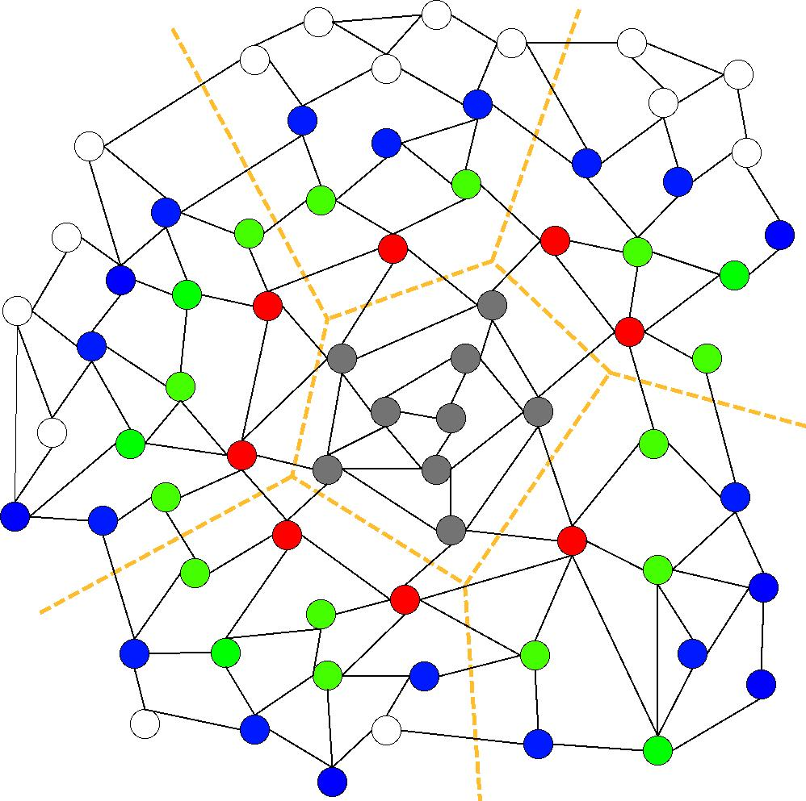
Communication Avoiding Kernels: The Matrix Powers Kernel : [Ax, A²x, …, A^{k}x]
Same idea works for general sparse matrices
Notes:
Red needed for k=1
Green also needed for k=2
Blue also needed for k=3

Slide 35
Minimizing Communication of GMRES to solve Ax=b
GMRES: find x in span{b,Ab,…,A^{k}b} minimizing || Ax-b ||₂
Standard GMRES
for i=1 to k
w = A · v(i-1) … SpMV
MGS(w, v(0),…,v(i-1))
update v(i), H
endfor
solve LSQ problem with H
Communication-avoiding GMRES
W = [ v, Av, A²v, … , A^{k}v ]
[Q,R] = TSQR(W)
… “Tall Skinny QR”
build H from R
solve LSQ problem with H
Sequential case: #words moved decreases by a factor of k
Parallel case: #messages decreases by a factor of k
Oops – W from power method, precision lost!
Need different polynomials than A^{k} for stability
35

Slide 36
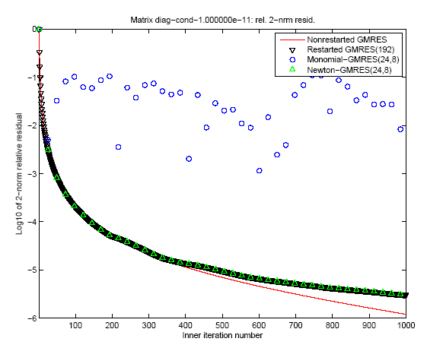
“Monomial” basis [Ax,…,A^{k}x]
fails to converge
Different polynomial basis [p₁(A)x,…,p_{k}(A)x]
does converge
36

Slide 37
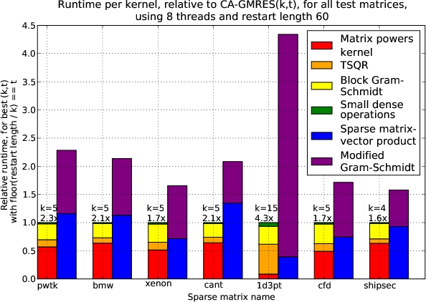
Speed ups of GMRES on 8-core Intel Clovertown
Requires Co-tuning Kernels
[MHDY09]
37

Slide 38
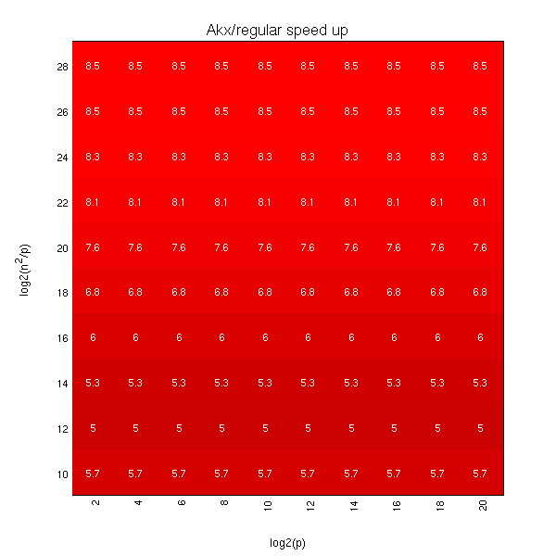
Exascale predicted speedups for Matrix Powers Kernel over SpMV for 2D Poisson (5 point stencil)
log₂ (n²/p) =
log₂ (memory_per_proc)
log₂ (p)

Slide 39
Summary of Iterative Linear Algebra
New Lower bounds, optimal algorithms, big speedups in theory and practice
Lots of other progress, open problems
GMRES, CG, BiCGStab, Arnoldi, Lanczos reorganized
Other Krylov methods?
Recognizing stable variants more easily?
Avoiding communication with preconditioning harder
“Hierarchically semi-separable” preconditioners work
Autotuning

Slide 40
Summary
Time to redesign all linear algebra
algorithms and software
And eventually all of applied mathematics
Don’t Communic…

Slide 41
Collaborators and Supporters
Collaborators
Michael Anderson (UCB), Grey Ballard (UCB), Erin Carson (UCB), Jack Dongarra (UTK), Ioana Dumitriu (U. Wash), Laura Grigori (INRIA), Ming Gu (UCB), Mark Hoemmen (Sandia NL), Olga Holtz (UCB & TU Berlin), Nick Knight (UCB), Julien Langou, (U Colo. Denver), Marghoob Mohiyuddin (UCB), Oded Schwartz (TU Berlin), Edgar Solomonik (UCB), Michelle Strout (Colo. SU), Vasily Volkov (UCB), Sam Williams (LBNL), Hua Xiang (INRIA), Kathy Yelick (UCB & LBNL)
Other members of the ParLab, BEBOP, CACHE, EASI, MAGMA, PLASMA, TOPS projects
Supporters
NSF, DOE, UC Discovery
Intel, Microsoft, Mathworks, National Instruments, NEC, Nokia, NVIDIA, Samsung, Sun

Slide 42
For further information
www.cs.berkeley.edu/~demmel
Papers
bebop.cs.berkeley.edu
www.netlib.org/lapack/lawns
1-week-short course – slides and video
www.ba.cnr.it/ISSNLA2010
Google “parallel computing course”

Slide 43
We’re hiring!
Seeking a postdoc / software engineer to help develop the next versions of LAPACK and ScaLAPACK

Slide 44
Summary
Time to redesign all linear algebra
algorithms and software
And eventually all of applied mathematics…

Slide 45
7 Dwarfs of High Performance Computing (HPC)
Monte Carlo
45
Notes:
45
Some people might subdivide, some might combine them together
Trying to stretch a computer architecture then you can do subcategories as well
Graph Traversal = Probabilistic Models
N-Body = Particle Methods, …

Slide 46
7 Dwarfs – Are they enough?
Monte Carlo
46
Notes:
46
Some people might subdivide, some might combine them together
Trying to stretch a computer architecture then you can do subcategories as well
Graph Traversal = Probabilistic Models
N-Body = Particle Methods, …

Slide 47
13 Motifs (nee “Dwarf”) of Parallel Computing Popularity: (Red Hot / Blue Cool)
Monte Carlo
47
Notes:
47
Some people might subdivide, some might combine them together
Trying to stretch a computer architecture then you can do subcategories as well
Graph Traversal = Probabilistic Models
N-Body = Particle Methods, …

Slide 48
Motifs in ParLab Applications (Red Hot / Blue Cool)
What happened to Monte Carlo?
48
Notes:
48
Some people might subdivide, some might combine them together
Trying to stretch a computer architecture then you can do subcategories as well
Graph Traversal = Probabilistic Models
N-Body = Particle Methods, …

