Slide 1

Dynamic Community Structure in Adaptive Systems
Dani S. Bassett
Department of Physics
University of California Santa Barbara

Slide 2
Dynamics of Adaptive Systems
Single snapshot
time, t
Network structure at one time point may not be representative.
Network structure could change
  Monotonically from one topological organization to another (e.g., regular -> random)
  According to some principle (e.g., randomly)
  By losing or gaining edges or nodes
  Retain the same topological structure but change nodal roles within that structure.
Notes:
First of all I need to explain what I mean by the dynamics of adaptive systems. I am specifically thinking in terms of the framework of complex networks. So on the left hand side, we see the network structure at a single snapshot of a toy dynamical system. On the right hand side, we see the same system only this time taking snapshots at several instances in time. From this example, we can see first that network structure at one time point may not be representative of the system throughout time. In other words, network structure can change, and it can change in many different ways. For example, network structure can change monotonically from one topological organization to another (for example, regular to random), or it can change according to some principle (for instance randomly). Another possibility is that the network could lose or gain edges or nodes. Another more subtle possibility is that the network could retain the same topological structure but nodes could change roles within that large-scale structure.
Transition: To investigate these various possibilities, we will be using a case study of brain network architecture during human learning. In this case, we expect dynamic changes in network structure to underlie the ability to learn.

Slide 3
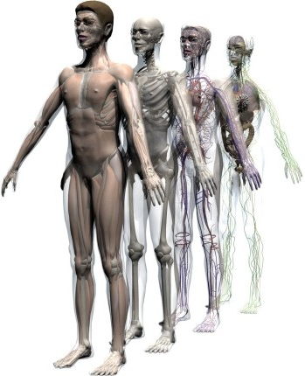
The Human as an Adaptive System
Notes:
Our model adaptive system will be the human body which is composed of many subsystems which react dynamically to both the external and internal world. There are in fact many subsystems that we can study, but we will focus on just two subsystems.
3

Slide 4
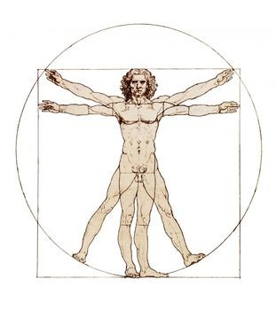
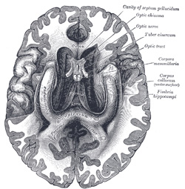
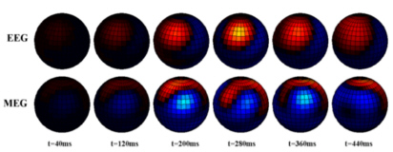

Brain and Behavior
Case study: brain network architecture during human learning
Case study: behavior network architecture during motor movements
Notes:
Changes structurally in hardwired connections and functionally and dynamically in those areas of the brain that talk to one another. Both change during learning.
Principles movements that have underlying organizational principles that we are going to try to uncover
End with first we are going to start with the human brain.
4

Slide 5
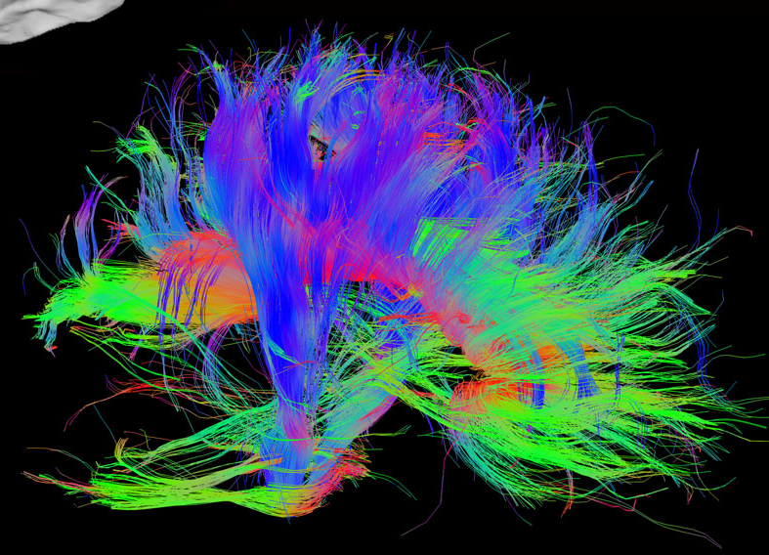
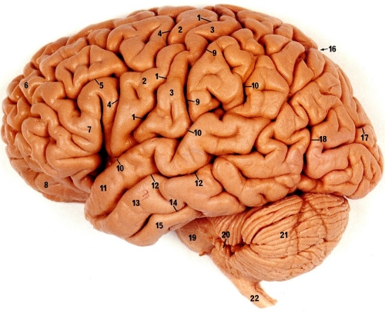
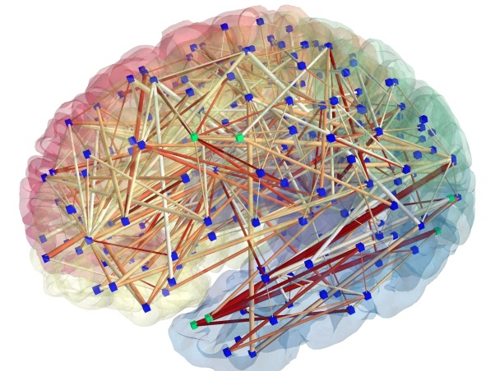
Human Brain Functional Networks
Hard-wired network
Anatomical
Functional
Dynamic network
Notes:
Transition: To investigate these various possibilities, we will be using a case study of brain network architecture during human learning. In this case, we expect dynamic changes in network structure to underlie the ability to learn. Focus on learning.
Look at dynamic network specifically when the system needs to adapt, so that is during a learning paradigm. We are going to teach people how to do something and then watch how their brain networks change.
5

Slide 6






Learning and Modularity
A modular system is a system composed of modules, or subcomponents which can each be altered separately without affecting the function of the other modules.
Modularity facilitates adaptability in three ways: dissociation, duplication and divergence, and co-option.
Learning requires a system to be adaptable.
  For example, human learning requires flexibility to adapt existing brain function and precision in selecting new neurophysiological activities to drive desired behavior.
Selective adaptability is naturally provided by modular structure.
Notes:
First we can ask what we know about learning. Learning requires a system to be adaptable. For example, human learning requires flexibility to adapt existing brain function and precision in selecting new neurophysiological activities to drive desired behavior. This selective adaptability is naturally provided by modular structure. By a modular structure, I mean a system composed of modules, or subcomponents which can each be altered separately without affecting the function of the other modules. So in this toy picture here, I have a single system which is composed of four separate modules. And these four modules can be further subdivided into four smaller modules, in a hierarchically modular organization. In this talk, however, I will be focusing just on the first level of decomposition: a system into its largest modules. This modularity facilitates adaptability in three ways: dissociation (the change of one module without affecting the others), duplication (the duplication of a module) and divergence (the change in that new module’s function), and co-option, which is the change in function of an old module. This concept of modularity is also consistent with what we know of the brain: brain regions act together in an attention circuit, and a circuit involved with emotion processing.
6

Slide 7
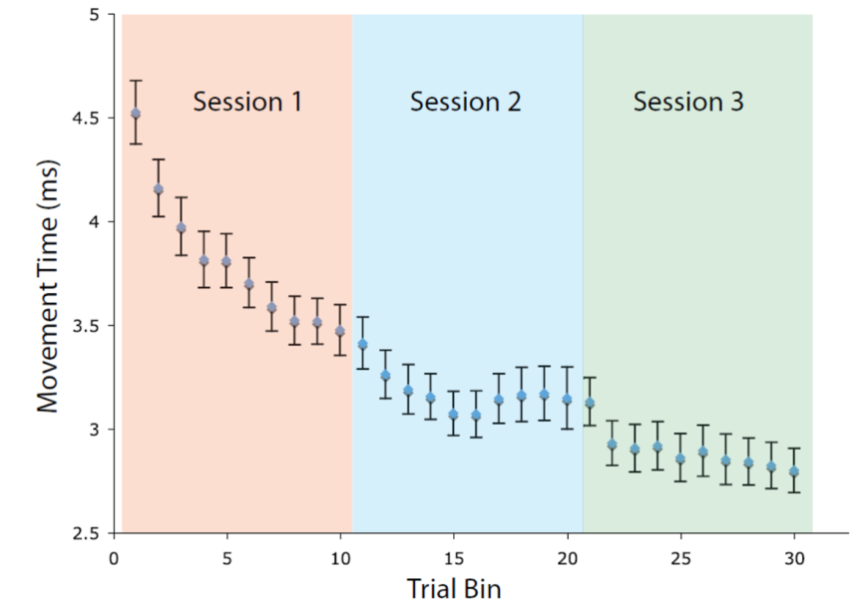
Model System: Motor Learning
Button Box Sequence
Experiment:
Behavior:
Movement Time, s
Notes:
The particular example that we will be examining is human learning of a simple motor skill. In this case, we give each subject a button box with 4 color-coded buttons. Visually, each participant is presented with a sequence of notes on a pseudo-musical staff. Each of the notes correspond to each button on the button box. 6 different sequences are used, and individuals practice these sequences in an fMRI scanner for 69 minutes on three different days.
7

Slide 8
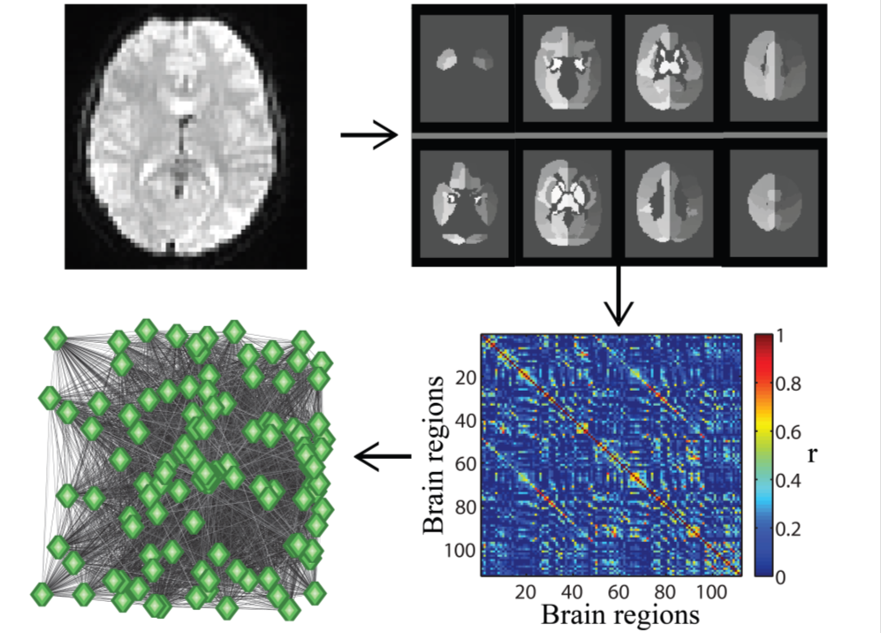
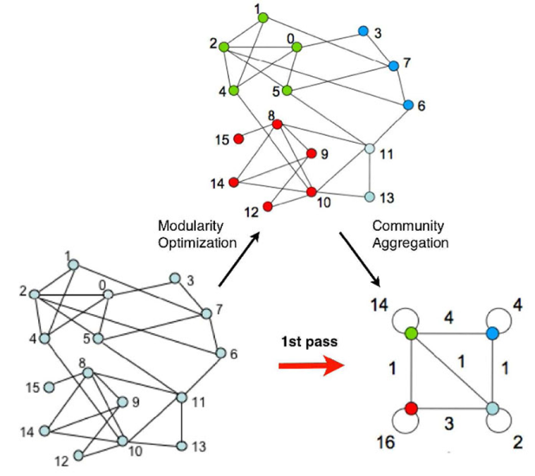
How do we measure modularity?
fMRI imaging
Functional Parcellation
Functional Connectivity
Schematic of Brain Network Construction
Network Modularity
Functional Network
Notes:
So our next question is how do we test for modularity in brain function? We begin with fMRI images, which code the activity of the brain in small 2-3mm cubes. We reduce the dimensionality of the problem by subdividing the entire brain into discrete anatomical subunits by averaging the activity within each larger-scale region. Then we compute the correlation between the regional mean time series to create an NxN functional connectivity matrix where N is the number of regions in the functional parcellation. This matrix can be represented as a weighted network in which we can look for communities or modules. Community detection is where we take a network and look for groups of nodes which are more highly connected to one another than to nodes in other groups.
8

Slide 9
Temporal Scales of the Experiment
Using fMRI, we study the learning of a motor skill over multiple scanning sessions. We expect that we might see functional connectivity modules associated with motor function, visual processing, etc. Since learning occurs over multiple time scales, we decide to use a multiscale analysis:
time
Complete Experiment (3.45hr)
Session One (69min)
Session Two (69min)
Session Three (69min)
Twenty-Five Intra-Session Windows, Each ~3.45min Long
Notes:
Learning as a phenomenon occurs over a range of temporal scales. Some parts of learning occur very quickly, over short time scales, and other parts of learning occur over longer time scales – on the order of days. So in this study, we will look for modularity over a variety of time scales. First, we will look over the complete experiment, which took a total of 3.45 hours. Next we look at each individual training day separately, create functional connectivity matrices based on the time series in that session, and then look for modularity. Finally, we subdivide the individual experimental sessions into 25 smaller time windows. In each time window, we determine the mean regional time series, compute the correlation matrix, and then look for modularity.
9

Slide 10
Long Time Scales
time
Complete Experiment (3.45hr)

Slide 11
Intermediate Time Scales
Session 1
Session 2
Session 3
time
Session One (69min)
Session Two (69min)
Session Three (69min)

Slide 12
Short Time Scales
time
Twenty-Five Intra-Session Windows, Each ~3.45min Long

Slide 13
Temporal Evolution of Modular Architecture
What if we want to not only measure the temporal dependence of modular architecture, but also the temporal evolution of that architecture? We need a new framework.
Community detection can now be performed on this linked multilayered network to find modules with longevity in the temporal domain.
Mucha et al. 2010

Slide 14
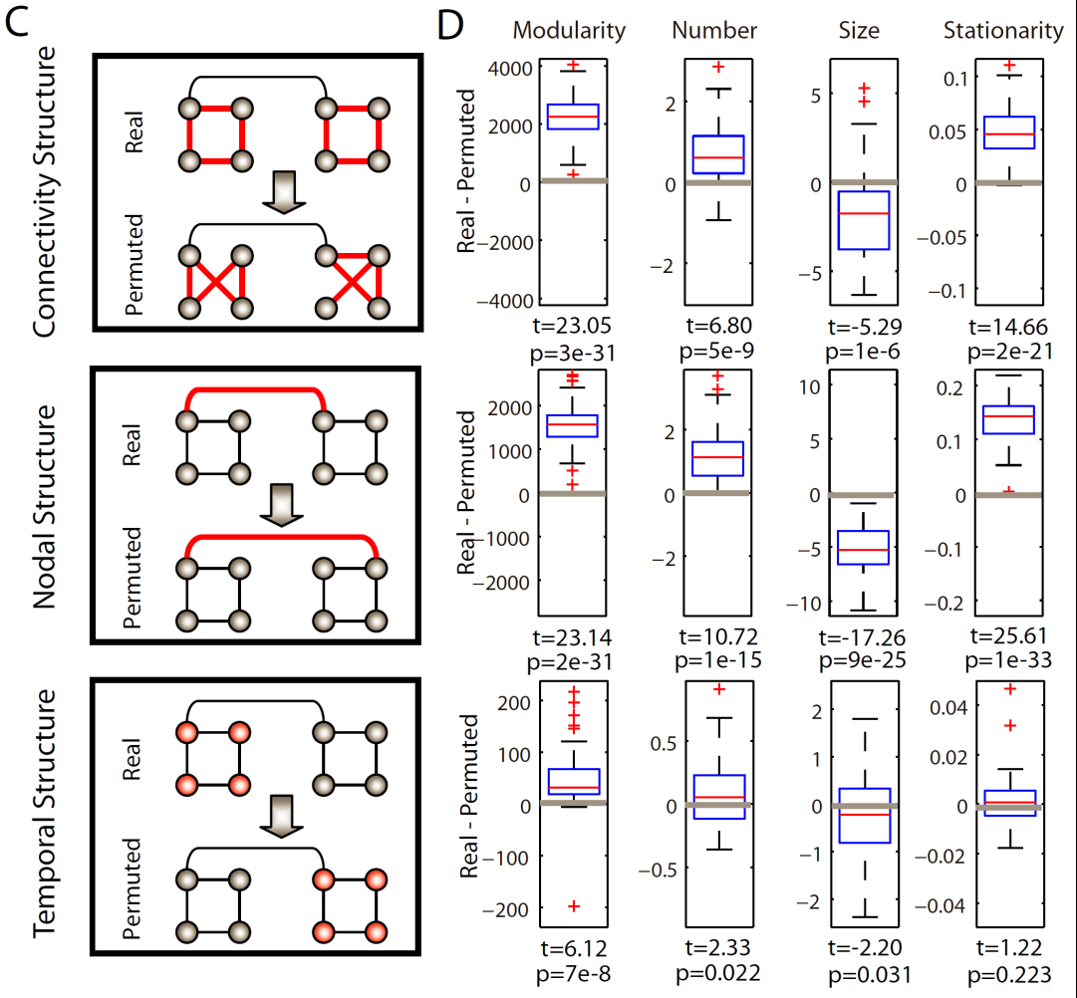
Temporal Evolution of Modular Architecture Statistical Testing
We constructed three separate null models to statistically test the hypothesis that the extent of dynamic modularity in the human brain was unexpected in a random system: connectional, nodal, and temporal.
1) Is the topological organization of cortical connectivity highly structured
2) Do diverse brain regions perform distinct non-interchangeable tasks throughout the experiment?
3) Is the evolution of modular architecture in human brain function is cohesive in time?

Slide 15
Temporal Evolution of Modular Architecture Statistical Testing
We constructed three separate null models to statistically test the hypothesis that the extent of dynamic modularity in the human brain was unexpected in a random system: connectional, nodal, and temporal.
1) The topological organization of cortical connectivity is highly structured
2) Diverse brain regions perform distinct non-interchangeable tasks throughout the experiment
3) The evolution of modular architecture in human brain function is cohesive in time.

Slide 16
Characterizing the Dynamics During Learning
Single snapshot
time, t
Network structure could change
  Monotonically from one topological organization to another (e.g., regular -> random)
    Result: Gross metrics including the modularity, number of modules, size of modules, and stationarity did not change significantly over the three days of practice.
  Retain the same topological structure but change nodal roles within that structure.
Option 1
Option 2
Notes:
Now that we know there is some significant temporal evolution of modular structure, we next ask how we can characterize those dynamics. Let’s go back to the slide I showed previously and ask which of these might describe the dynamic network structure that we see in the brain.
16

Slide 17
Flexibility of Module Composition
Now that we know there is significant structure here, we can ask how it relates to learning over the three scanning sessions.
During learning, flexibility first increases and then decreases.

Slide 18
Flexibility and Learning
The flexibility in the early stages of learning was unrelated to the extent of learning in the same experimental session, as measured by the swiftness of the motor response (p>0.13 by permutation testing).
Learning
Learning
However, the flexibility exhibited by the brain’s functional architecture in one session could be used as a predictor of the degree of learning in the following experimental session: p=0.001 for predicting Session 2 learning from Session 1 flexibility, and p=0.009 for predicting Session 3 learning from Session 2 flexibility.
Notes:
Talk about ICC results.
18

Slide 19
Flexibility and Learning: Anatomy
We can next ask which brain regions are driving this relationship?
Regions whose flexibility is significantly (p<.05 uncorrected) predictive of learning in the following session are distributed throughout the cortex.

Slide 20
Neurophysiological Correlates of Flexibility
Biologically, flexibility might be driven by physiological processes that facilitate the participation of cortical regions in multiple functional communities.
  Learning a motor skill induces changes in the structure and connectivity of the cortex accompanied by increased excitability and decreased inhibition of neural circuitry.
Flexibility might also be driven by task-dependent processes that require the capacity to balance learning across subtasks.
  This experiment demanded that subjects master the performance of using the response box, decoding the stimulus, performing precise movements, shifting attention between stimuli, and switching movement patterns.
Applications: When/who to teach; Neurorehabilitation

Slide 21
Brain and Behavior
Case study: brain network architecture during human learning
Case study: behavior network architecture during motor movements
Notes:
21

Slide 22
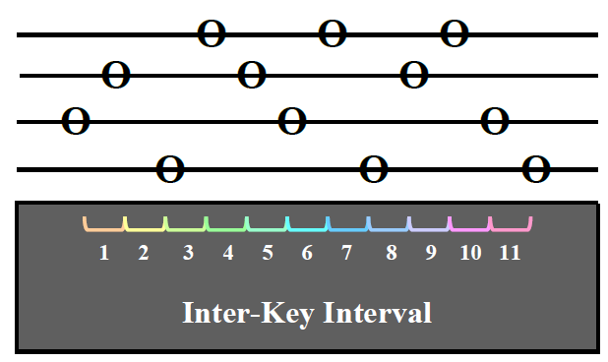
Behavioral Chunking
Sequence of Movements:
Question: Do humans “chunk” movements?

Slide 23
Behavioral Data
Duration
Inter-Key Interval

Slide 24
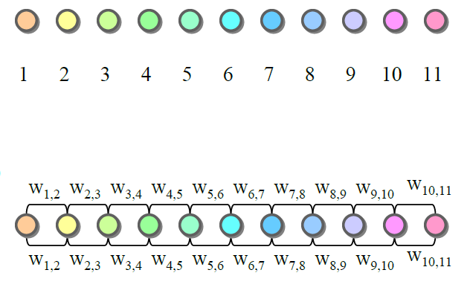
Defining Network Nodes & Edges
11 Nodes:
Undirected, Sequential Edges:
Only allow chunks to form between sequential movements.
Notes:
24

Slide 25
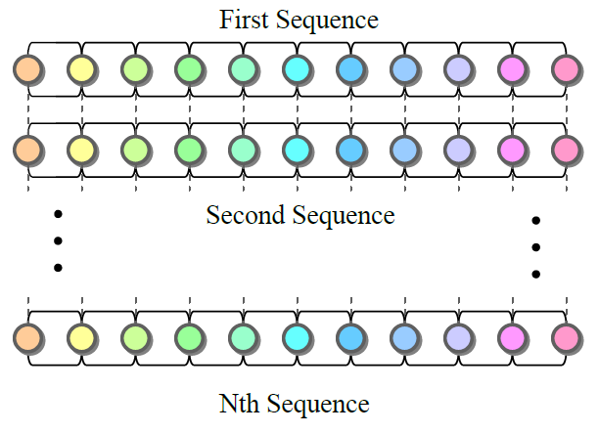
Defining the Multilayer Network
Take advantage of the many trials to increase statistical dependence of chunk solution in consecutive trials – and also enable visualization of chunking evolution.

Slide 26
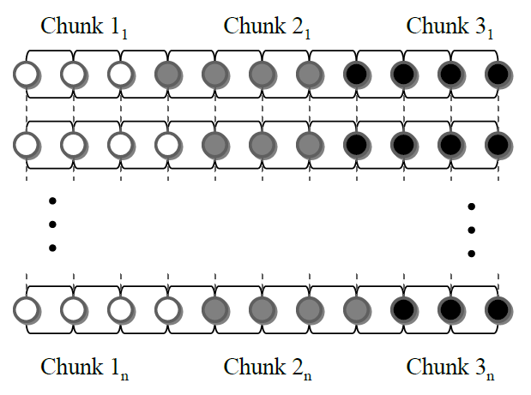
Perform Community Detection
Use multilayer community detection.

Slide 27
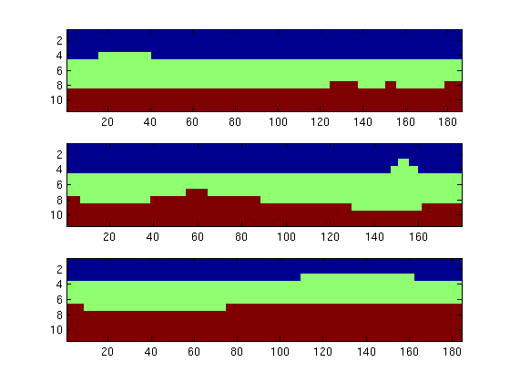
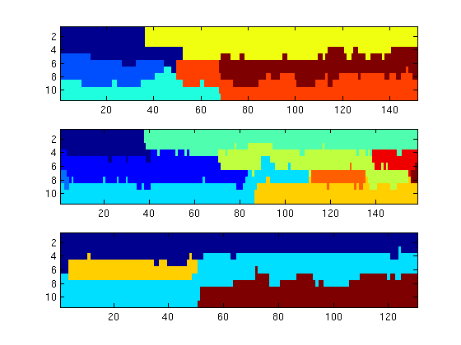
Chunking as a Function of Time
Subject 4
Subject 22
Node Number
Node Number
Slice (Repitition in Time)
Slice (Repitition in Time)
Significant inter-individual variability

Slide 28
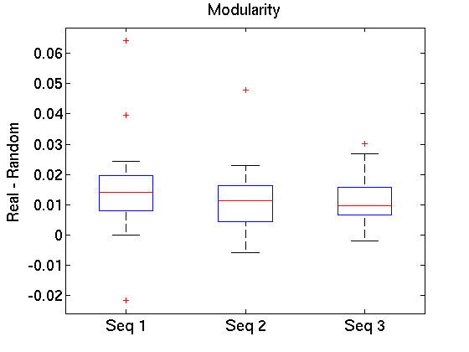
Chunking Significance
Compare the empirical modularity to that of a nodal null model, where similar nodal identity between sequences is disrupted.

Slide 29
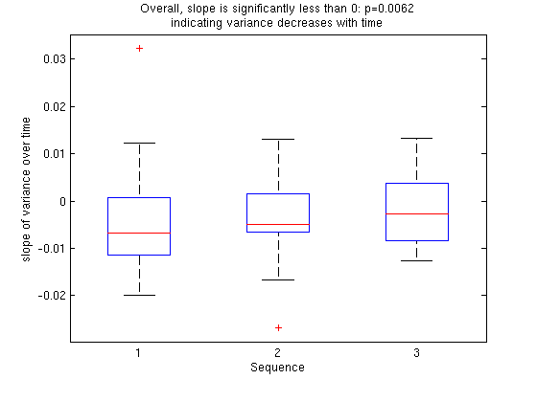
Chunking Variance and Learning
Theoretically, chunks should get “chunkier” with time.
Overall, slope is significantly less than 0: p=0.0062 indicating variance decreases with time
Slope of variance over time
1 2 3
Sequence Number
Notes:
Test network theories that have been posited previously.

Slide 30
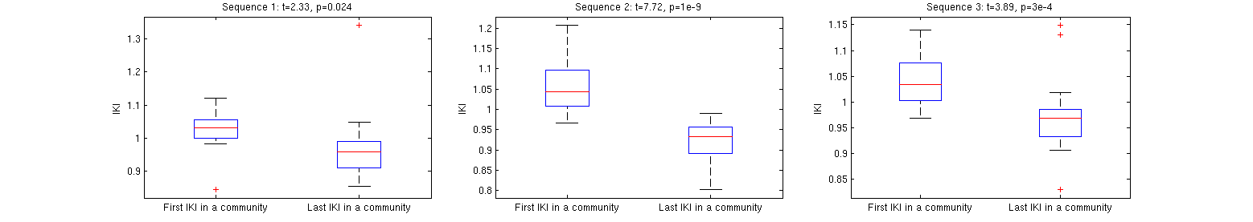
Preparing for the Next Chunk
Slow IKIs are thought to indicate the brain preparing for a new set of movements, letting go of the old set, and focusing on the new set.
t=2.33, p=0.024
t=7.72, p=1e-9
t=3.89, p=3e-4
IKI Duration
IKI Duration
IKI Duration
1rst
Last
1rst
Last
1rst
Last
The first movement in a chunk was consistently slower than the last movement in a chunk, suggesting that indeed those slow movements are the beginning of new chunks.

Slide 31
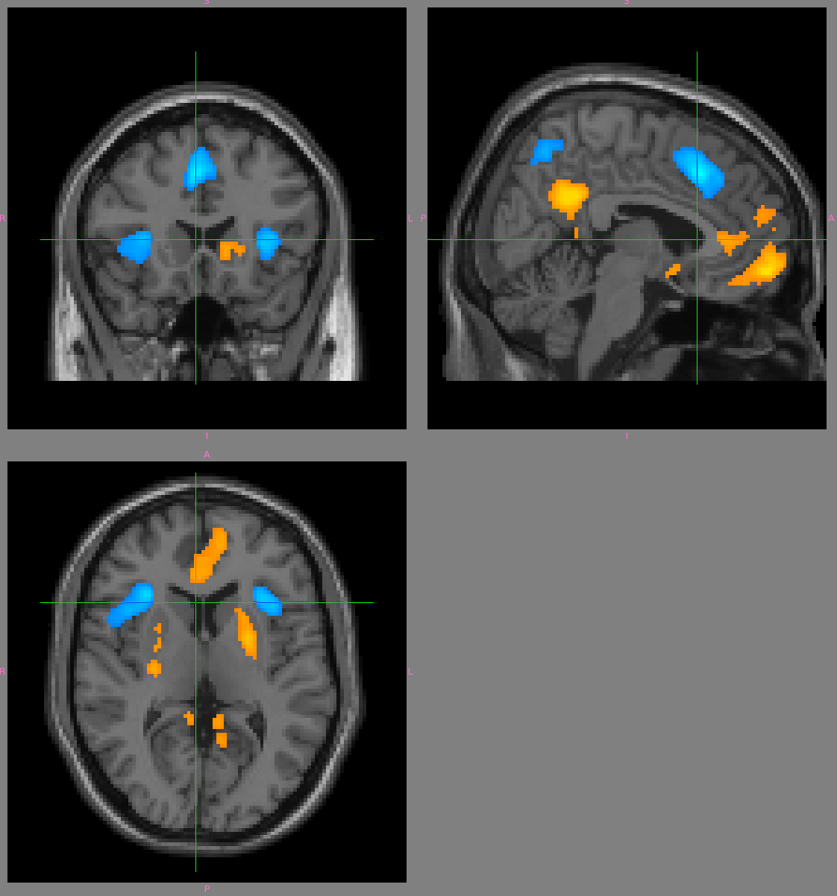
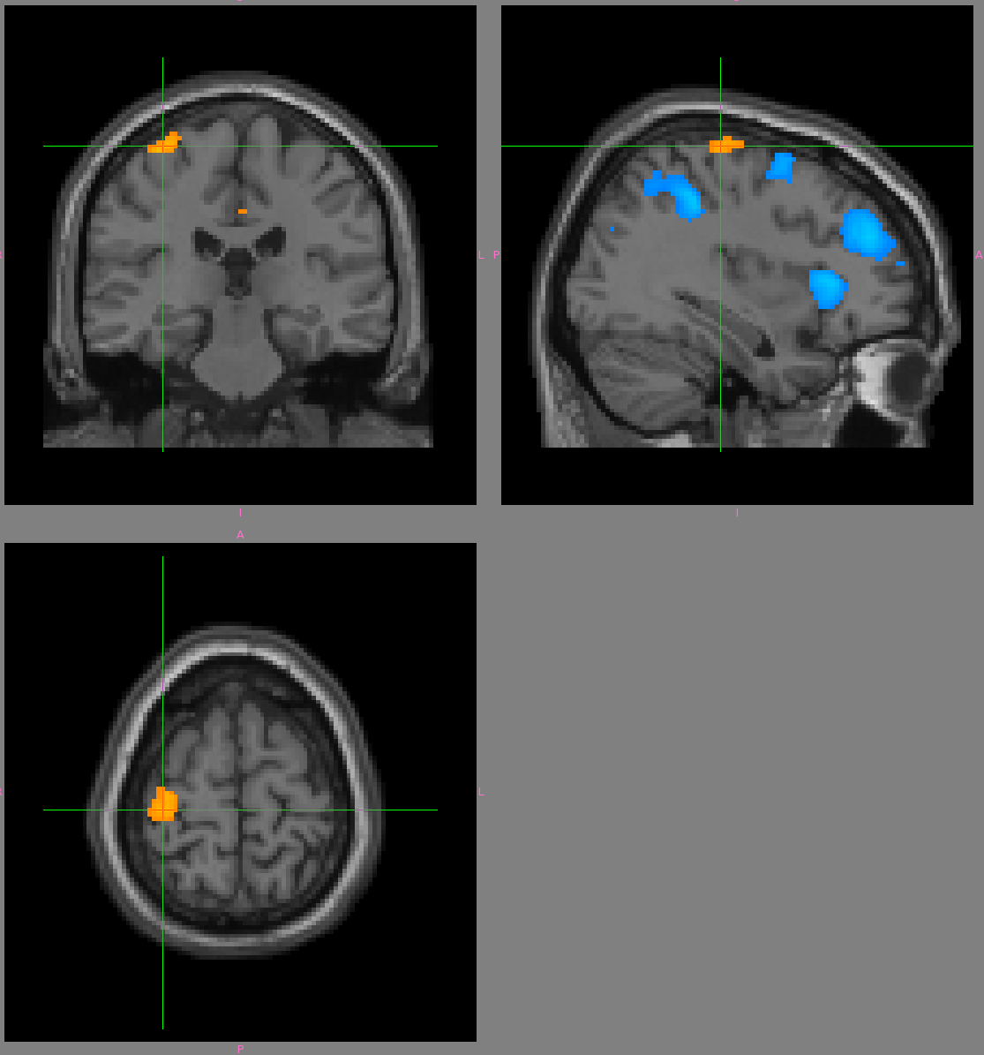
Chunking Variance and the Brain
Attentional and
Processing Areas
Motor Cortex
Resting State Areas
As chunking variance decreases with learning,
motor and mind-wandering areas turn ON
while processing areas turn OFF.

Slide 32
Final Thoughts
Explored the human as a model system for dynamic adaptivity of network organization in both brain activity and motor behavior
Described two biological applications of dynamic community detection to address long standing questions in human neuroscience.
Advantages of neuroscientific data
  Statistical Advantages: N>>1
  Dynamic
  Spatial constraints (embedding)
  Physical constraints on energy metabolism, size, etc.

Slide 33








Acknowledgements
University of Cambridge:
Prof. Ed Bullmore
Daniel Greenfield
Prof. Simon Moore
University of Oxford
Prof. Mason A. Porter
Central Institute of Mental Health
Andreas Meyer-Lindenberg
National Institute of Mental Health
Daniel Weinberger
Beth Verchinski
Venkata Mattay
University of California Santa Barbara
Prof. Scott Grafton
Prof. Jean Carlson
Nick Wymbs
Siemens Medical Solutions
Vibhas Deshpande
University of California Los Angeles
Jesse Brown
University of North Carolina Chapel Hill
Prof. Peter Mucha
ONR MURI: Next Generation Network Science

Slide 34
Questions?

