Slide 1
Uncertainty Management In Nuclear Engineering
Hybrid Framework for
Variational and Sampling Methods
SAMSI Program on Uncertainty Quantification:
Engineering and Renewable Energy
RTP, NC
September 20th, 2011
Hany S. Abdel-Khalik, Assistant Professor
PI, CASL VUQ Focus Area
North Carolina State University

Slide 2
Motivation: Role of Modeling and Simulation
Science-based modeling and simulation is poised to have great impact on decision making process for the upkeep of existing systems, and optimizing design of future systems
Two main challenges persist:
  Why should decision makers believe M&S results?
  How to be computationally efficient?

Slide 3
OBJECTIVE: Uncertainty Management
Employ UQ to estimate all possible outcomes and their probabilities
Identify key sources of uncertainty and their contribution to total uncertainty
  Must be able to calculate the change in response due to change in sources of uncertainty (sensitivity analysis SA)
Employ measurements to reduce epistemic uncertainties
  Must be able to correct for epistemic sources of uncertainties to minimize differences between measurements and predictions
  (inverse problem, aka data assimilation DA)

Slide 4
Sources of Uncertainty
Input parameters
  Parameters input to models are often measured or evaluated
  by pre-processor models
  Measurements and/or pre-process introduce uncertainties
  Parameters uncertainties are the easiest to propagate
Numerical Discretization
  Real complex models have no closed form solutions
  Digitized forms of the continuous equations must be prepared
  Numerical schemes vary in their stability and convergence properties
  For well-behaved numerical schemes, numerical errors
  can be estimated
Model form
  Models are approximation to reality
  The quality of approximation reflects level of insight into physical phenomena.
  With more measurements, physicists are often able to
  formulate better models
  Most difficult to evaluate especially with limited measurements

Slide 5
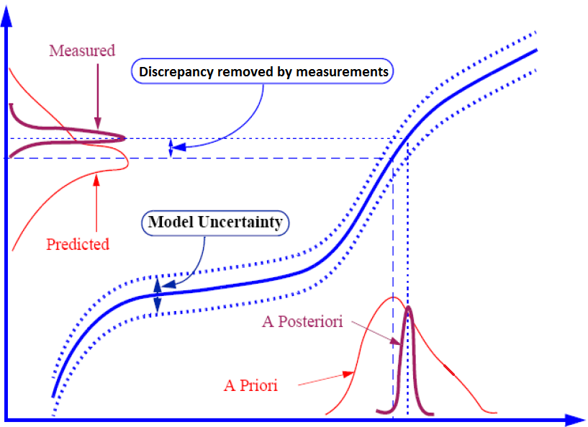
Uncertainty Management
Output Responses
Input Parameters

Slide 6
UQ Approaches
Applied in Nuclear Engineering Community
Sampling approach
  Analysis of variance, Scatter plots, Variance based decomposition
  Efficient sampling strategies
Surrogate (ROM) approach
  Response Surface Methods
    Employing forward model only
        Polynomial Chaos
        Stochastic Collocation
        MARS
    Employing forward and adjoint models
        Gradient Enhanced Polynomial Chaos
  Variational Methods via adjoint model construction
  Hybrid Subspace Methods
    Response Surface Methods + Variational Methods

Slide 7
Nuclear Engineering
Models

Slide 8
Nuclear Reactor
Device that converts nuclear energy into electricity via a thermodynamic cycle.
Nuclear energy is released primarily via fission of nuclear fuel.
Physics governing behavior of nuclear reactor include:
  Radiation transport
  Heat transport through the fuel
  Fluid Dynamics and Thermal analysis (Thermal-Hydraulics)
  Chemistry
  Fuel performance
  Etc.

Slide 9
Nuclear Reactions
Interaction of single nuclear particles cannot be predicted analytically.
However only ensemble average of interactions of many particles can be statistically estimated.
The constant (cross-section) characterizes probability of interaction between many particles of type A and many particles with type B; and are experimentally evaluated.

Slide 10
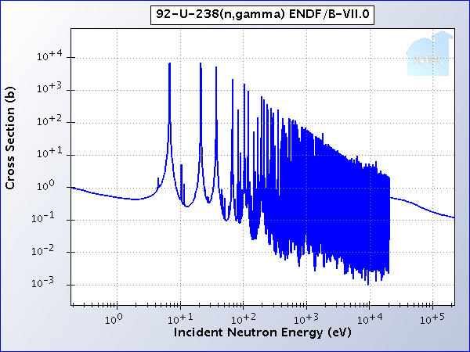
Cross-Section Resonances (Example)
U²³⁸ cross-section uncertainty in resonance region leads to 0.15% uncertainty in neutron multiplication
($600K in Fuel Cycle Cost)
21 eV
37 eV
66 eV

Slide 11
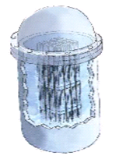




Core Design Heterogeneity
Uranium is contained in Ceramic fuel pellet
Fuel pellets are stacked together
Stack is contained in metal rod
Rods are bundled together in an assembly
Assemblies are combined to create the reactor core
Source: http://www.nei.org

Slide 12
Physical Model
The ensemble average of neutron distribution in a reactor can be described by Boltzmann Equation:

Slide 13
Nuclear Reactors Modeling
Wide range of scales: energy, length, and time, varying by several orders in magnitude
Wide range of physics
Fully resolved description of reactor is not practical
Physical Model Reduction adopted to render calculations in practical run times
Uranium is contained in Ceramic fuel pellet
Fuel pellets are stacked together
Stack is contained in metal rod
Rods are bundled together in an assembly
Assemblies are combined to create the reactor core
Spatial Heterogeneity of nuclear reactor core Design
Cross-Sections dependence on neutron energy

Slide 14
ROM via Multi-Scale Modeling
Given problem complexity, subdivide problem domain into sub-domains
Sub-domain, generally involving different physics, scale, and mathematical representation, and based on assumed boundary conditions.

Slide 15
ROM via Multi-Scale Modeling (Cont.)
Coarse-scale model describes macroscopic system behavior
Sub-domain solutions are integrated to calculate coarse-scale parameters for the coarse-scale model.

Slide 16
Uncertainty Management

Slide 17
Mathematical Description
Most real-world models consist of two stages:
  Constraints:
  Response:
Example:

Slide 18
Uncertainty Management Requirements
To estimate uncertainty and sensitivities to enable UQ/SA/DA, one must calculate:
Direct Effect
Indirect Effect

Slide 19
determined by user-defined ranges for
possible parameters variations
variation in state due to parameters variations;
requires solution of forward model
describes how responses of interest depend on
the state; easiest to determine for a given
response function
only quantity needed by UQ
must be available for SA and DA

Slide 20
Sampling approach
  Sample x and determine φ and R
  Perform statistical analysis on R
  Employ (x, R) samples to estimate sensitivities of R wrt x
Surrogate (ROM) approach
  Response Surface Methods (RSM)
    Use limited samples to find a ROM relating R and x
    Sample the ROM many more times to get UQ results
  Variational Methods
    Bypass the evaluation of φ, and directly find a ROM relating
    R’s first order variations wrt x.
    Use deterministic formula to get UQ; no further samples required
  Hybrid Subspace Methods
    Employ variational methods to find first-order ROM
    Sample ROM to find reduced set of input parameters x_{r}
    Use RSM to relate R and x_{r} and get UQ results

Slide 21
RSM vs. Variational Approach:
Demo Toy Problem
Constraint:
Response:
Adjoint Problem: Response:
‘solved once for a given response’ ‘All possible response variations
can be estimated cheaply’

Slide 22
Variational Approach for Uncertainty Management
Given a well-behaved model, Taylor-series expand:
Given first-order derivatives evaluated by VA,
the surrogate is given by:
Employ the surrogate in place of original model for UQ, SA, and DA

Slide 23
Variational Approach
Can be used to estimate first order variations of a given response with respect to all input parameters using a single adjoint evaluation
For models with m responses, m executions of the adjoint model are required
For linear models (or quasi-linear models), it is the most efficient approach to build the surrogate
For higher order variational estimates (applied to nonlinear models), the number of adjoint evaluations becomes dependent on n.
  Ex. for quadratic models, n adjoints are needed.

Slide 24
Challenges of RSM Approach
Hard to determine quality of predictions at any points not used to generate the surrogate?
Solution: Leave-some-out Approach
  Generate the surrogate with a reduced number of points
  Use the surrogate to predict the left-out points
Determine the surrogate’s functional form (surface)?
How to select the points used to train the surrogate?
  Number of points grow exponentially with number of input parameters
  Great deal of research goes into reducing number of training points

Slide 25
Challenges of UQ in Nuclear Eng
Typical reactor models require long execution times rendering their repeated execution computationally impractical:
  Contain millions of inputs and outputs
  Require repeated forward and/or adjoint model executions
  Strongly nonlinear
  Coupled in sequential and/or circular manners
  Based on tightly and/or loosely coupled physics
  Employ multi-scale modeling phenomena
Responses’ PDFs deviate from Gaussian shapes, and must be accurately determined for safety analysis

Slide 26
Efficient Subspace Methods - Philosophy
Given the complexity of physics model, multi-scale strategies are employed to render practical execution times
Multi-scale strategies are motivated by engineering intuition; designers often interested in capturing macroscopic behavior
Multi-scale strategies involve repeated homogenization/averaging of fine-scale information to generate coarser information
Averaging = Integration = Lost degrees of Freedom
Why not design our solution algorithms to take advantage of lost degrees of freedom?
If codes are already written, why not reduce them first before tightly/loosely coupling them, and to perform UQ/SA/DA

Slide 27
ESM: Toy Problem
Consider:

Slide 28
ESM: Toy Problem
Original Model:
Reduction Step:
Reduced Model:

Slide 29
Efficient Subspace Methodology (ESM)
Consider:
Note that:

Slide 30
Tensor-Free Taylor Expansion
Introduce modified Taylor Series Expansion:
This expression implies:

Slide 31
Subspace Reduction Algorithm
Assume matrix of influential directions is known
One can employ a rank revealing decomposition to find the effective range for
Range finding algorithm may be employed:
  Employ random matrix-vector products of the form:
  Find the effective range:
  Check the error:

Slide 32
Subspace Methods - Algorithm
I/O variability can be described by matrix operators
Given large dense operator A, find low rank approximation:
Matrix elements available:
  A. Frieze, R. Kannan, and S. Vempala, Fast Monte Carlo algorithms for finding low rank approximations, in Proc. 39th Ann. IEEE Symp. Foundations of Computer Science (FOCS), 1998.
  ______, Fast Monte Carlo algorithms for finding low-rank approximations, J. Assoc. Comput. Mach., 51 (2004)
Only matrix-(transpose)-vector product available:
  H. Abdel-Khalik, Adaptive Core Simulation, PhD, NCSU 2004.
  P.-G. Martinsson, V. Rokhlin, and M. Tygert, A randomized algorithm for the approximation of matrices, Computer Science Dept. Tech. Report 1361, Yale Univ., New Haven, CT, 2006.

Slide 33
Singular Values Spectrum
How to determine a cut-off?
Well-Posed
Singular Value
Ill-Conditioned
Ill-Posed
Singular Value Triplet Index

Slide 34
Subspace-Based Hybridization
Approach #1
Methods Hybridization inside each components
Reduce subspace first, then employ forward method to sample the reduced subspace
Mapping
Original Model
Find Reduced
Input Parameters
Random Sampling of
1st Local Derivatives

Slide 35
Subspace-Based Hybridization
Approach #2
Hybridization across components
Employ different method(s) for each components, and perform subspace reduction across components interface
Mapping
Find Reduced Parameters

Slide 36
Implementation – Subspace Methods
Given a chain of codes, one attempts to reduce dimensionality at each I/O hand-shake
ESM Reduction

Slide 37
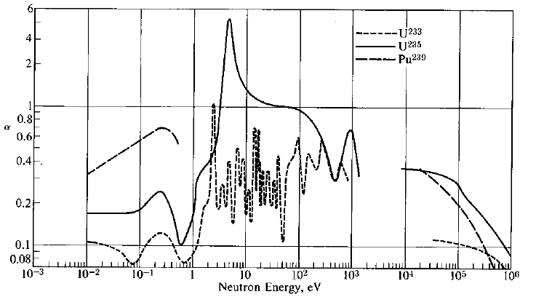
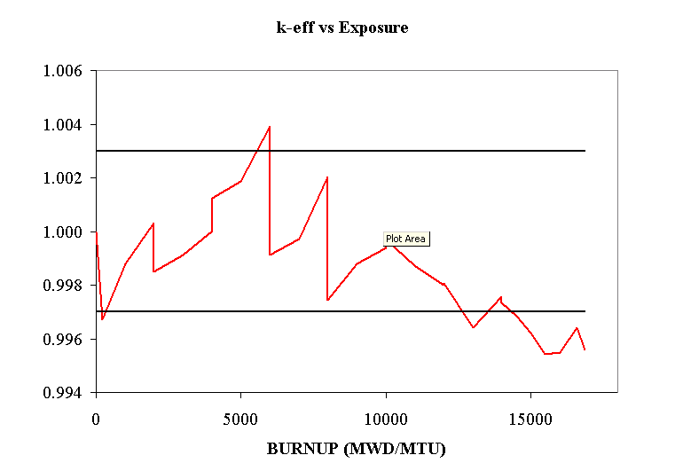
BWR Reactor Core Calculations
Hybrid subspace sampling approach, w/ linear approximation
Based on Work by Matthew Jessee, Hany Abdel-Khalik, and Paul Turinsky
ENDF
MG Gen Codes
MG XS
Lattice Calcs
FG XS
Core Calcs
k_{eff,} power, flux, margins, etc.

Slide 38
UQ and SA results
Core K-Effective & Axial Power Distribution

Slide 39
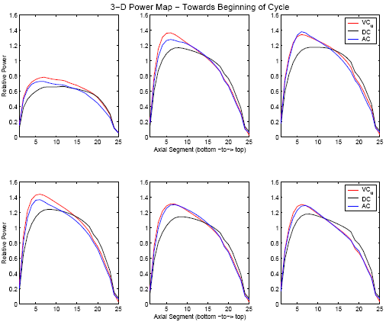
DA Results w/ Virtual plant data
Power Distribution

Slide 40
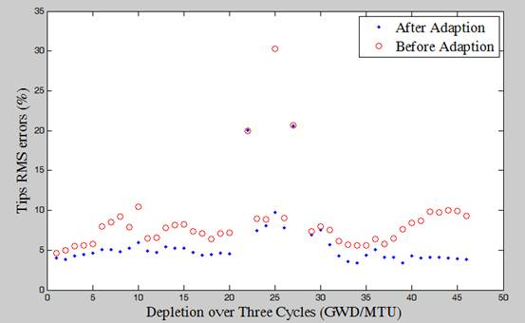
DA Results w/ Real Plant Data
Core Reactivity

Slide 41
Singular Values for Typical Reactor Models

Slide 42
UQ State-of-The-Art:
What we can do!
Linear or quasi-linear models with:
  few inputs and many outputs: smpl
  many inputs and few outputs: var
  many inputs and many outputs: hbrd var-smpl-sub
Nonlinear smooth models with:
  few inputs and many outputs: smpl, rsm
smpl: sampling methods
rsm: response surface methods
hbrd: hyhrid
var: variational
sub: subspace

Slide 43
UQ Ongoing R&D
Nonlinear smooth models:
  with many inputs and few/many responses:
  hbrd var-smpl-sub
Linear models coupled sequentially:
  Possible to reduce dimensionality of data streams at each code-to-code interface: hbrd-var-sub
Nonlinear models coupled sequentially:
  Possible: perform reduction at each code-to-code interface using a hbrd var-smpl-sub

Slide 44
UQ Challenges:
Currently Not Addressed
Nonlinear non-smooth models
(e.g. bifurcated models and discrete type events)
Nonlinear models coupled with feedback
How to estimate uncertainties for low-probability events, e.g. tails of probability distributions?
How to evaluate uncertainties on a routine basis for multi-physics multi-scale models?
How to efficiently aggregate all sources of uncertainties, including parameters, numerical, and model form errors?
How to identify validation domain beyond the available experimental data?
How to design experiments that are most sensitive to key sources of uncertainties?

Slide 45
Concluding Remarks
Most complex models can be ROM’ed. This is not coincidental due to the multi-scale strategy often employed.
Recent research in engineering and applied mathematics communities has shown that:
  It is possible to find ROM efficiently
  One can preserve accuracy of original complex model
Hybrid algorithms appear to have the highest potential of leveraging the benefits of various ROM techniques

Slide 46
UQ Education
Very little focus is given to UQ in
undergraduate and graduate education
Future workforce, expected to rely more on modeling and simulation, should be conversant in UQ methods
Ongoing educational efforts:
  Validation of Computer Models, Francois Hemez, LANL
  SA and UQ Methods, Michael Eldred, Sandia
  V&V & UQ, Ralph Smith, NCSU
  V&V&UQ in Nuclear Eng, Hany Abdel-Khalik, NCSU

Slide 47
Thank you for your attention
abdelkhalik@ncsu.edu

Slide 48
Tensor-Free Generalized Expansion
Introduce modified Taylor Series Expansion:
This expression implies:

